Slide 1
CLASS
PG Diploma in Artificial Intelligence

Slide 2
Areas of Work
Artificial Intelligence
Natural Language Processing
Machine Translation

Slide 3
TOPIC
Shallow Parsing and Deep Parsing

Slide 4
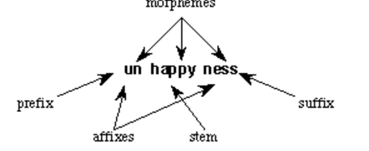
Morphological analysis (MA)
Morphology is the study of the structure and formation of words. Its most important unit is the morpheme, which is defined as the "minimal unit of meaning". Consider a word like: "unhappiness". This has three parts:
There are three morphemes, each carrying a certain amount of meaning. un means "not", while ness means "being in a state or condition". Happy is a free morpheme because it can appear on its own

Slide 5
Morphological analysis (MA)
Traditionally, the analysis of word structure (morphology) is divided into two basic fields as Inflection and derivation.
Inflection is the process of changing the form of a word so that it expresses information
        car / cars
        table / tables
        dog / dogs
While derivation is a word-creating process, Inflection constitutes different forms of any word.
Active - activity
approve - approval

Slide 6
Morphological analysis (MA)
The obvious use of Morphology Analysis in NLP systems is to reduce the number of forms of words to be stored. So, if there is already an entry for the base form of the verb sing, then it should be possible to add rules to map the nouns singer and singers onto the same entry.
This seems a little obscure, but an example will make it clear. The addition of 'er' to the word indicates that it is a person who is undertaking the action. This semantic information must be added to the stored information from the dictionary entry for the root form sing so that the correct meaning of the sentence can be found.

Slide 7
Morphological analysis (MA)
Derivational morphology is particularly useful for Machine Translation. Successful MT has to process large quantities of text which can contain many previously unseen words.
Some words are neologisms (that is, newly-coined words). If the analyzer can reduce these words to their base form, it may be able to translate that and, in effect, coin a new word in the target language by simply following rules. To give a couple of examples: neologisms often have a proper name as their root.

Slide 8
Multi-word expressions (MWEs)
In natural languages, words can occur in single units called simplex words or in a group of simplex words that function as a single unit, called Multiword Expressions (MWEs).
  (1.1) The marketing manager can learn how to take advantage of the growing database...
  (1.2) He will inherit when his grandfather kicks the bucket.
  (1.3) They were by and large of the type postulate...
  (1.4) You should also make a note of the serial number of your television video...
  Phrasal VERB - make up, get away with, set off, give up, look after

Slide 9
What’s Information Extraction (IE)
IE = text analytics = text mining = e-­‐discovery, etc.
The ultimate goal is to convert unstructured text into structured information (so information of interest can easily be picked up).
  unstructured data/text: email, PDF ﬁles, social media posts, tweets, text messages, blogs, basically any running text...
  structured data/text: databases (xlm, sql, etc.), ontologies, dictionaries, etc.

Slide 10
Named Entity Recognition (NER)
A very important task: ﬁnd and classify names in text.
An entity is a discrete thing like “C-DAC”
Named” means called “IBM” or “Big Blue” not “it” or “the company”
often extended in practice to things like dates, instances of products and chemical/biological substances that aren’t really entities…
But also used for times, dates, proteins, etc., which aren’t entities – easy to recognize semantic classes

Slide 11
Named Entity Recognition (NER)
A very important sub-­‐task: ﬁnd and classify names in text, for example:
you have a text, and you want to:
find things that are names: European
Commission, John Lloyd Jones, etc.
give them labels: ORG, PERS, etc.
The decision by the independent MP Andrew Wilkie to withdraw his support for the minority Labor government sounded dramatic but it should not further threaten its stability. When, a\er the 2010 election, Wilkie, Rob Oakeshott, Tony Windsor and the Greens agreed to support Labor, they gave just two guarantees: conﬁdence and supply.

Slide 12
Named Entity Recognition (NER)
A very important sub-­‐task: ﬁnd and classify names in text, for example:
The decision by the independent MP Andrew Wilkie to withdraw his support for the minority Labor government sounded dramatic but it should not further threaten its stability. When, a\er the 2010 election, Wilkie, Rob Oakeshott, Tony Windsor and the Greens agreed to support Labor, they gave just two guarantees: conﬁdence and supply.
Person Date Location Organization

Slide 13
Named Entity Recognition (NER)
The uses:
  Named entities can be indexed, linked oﬀ, etc.
  Sentiment can be attributed to companies or products
  A lot of IE relations are associations between named entities
  For question answering, answers are often named entities.
  Utilization of information during Machine Translation
Concretely:
  Many web pages tag various entities, with links to bio or topic pages, etc.
  Apple/Google/Microsoft/… smart recognizers for document content

Slide 14
Assignments
Information Extraction and Named Entity Recognition
Introducing the tasks:
Getting simple structured information out of text

Slide 15
part of speech
The part of speech explains how a word is used in a sentence. There are eight main parts of speech - nouns, pronouns, adjectives, verbs, adverbs, prepositions, conjunctions and interjections.
POS Tagging simply means labeling words with their appropriate Part-Of-Speech.
The most popular tag set is Penn Treebank tagset.

Slide 16
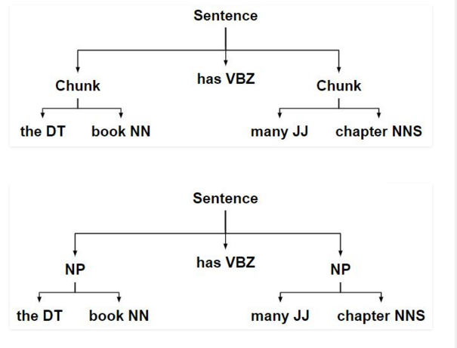
What is Chunking?
Chunking is a process of extracting phrases from unstructured text. Instead of just simple tokens which may not represent the actual meaning of the text, its advisable to use phrases such as “South Africa” as a single word instead of ‘South’ and ‘Africa’ separate words.

Slide 17
Sentence
INPUT SENTENCE :
In the Philosophy, Kashmir’s population is very distinctive.
PREPROCESSED OUTPUT:
In the Philosophy , Kashmir's population is very distinctive
Generator OUTPUT:
दर्शनशास्त्र में , कश्मीर की जनसंख्या बहुत विशिष्ट है

Slide 18
Assignments
A Part-Of-Speech Tagger (POS Tagger) is a piece of software that reads text in some language and assigns parts of speech to each word (and other token), such as noun, verb, adjective, etc

Slide 19
Assignments
Development of basic POS Tagger

